Slide 1
Summarization of a stack of papers using LLMs: Stage 3
By Arianna Matienzo, Atharva Dalvi, Khushi Nankani, Olu Ogunnirian

Slide 2
Recap about our project!
Over the course of this project, we set out to solve a key challenge faced by researchers today: the overwhelming volume of academic literature. Manually reviewing and summarizing papers is time-consuming, inconsistent, and prone to information overload. To tackle this, we’ve developed an automated summarization system powered by Large Language Models (LLMs).

Slide 3
Recap about our project!
Our approach breaks down the summarization task into three structured stages:
Topic Recognition – Using NLP models, we group research papers by subject matter to create topic-specific clusters.
Summarization – For each topic cluster, our system generates meaningful and concise summaries while preserving key technical details.
Collation – Finally, the topic-wise summaries are compiled into a single, well-organized document for easy reference.

Slide 4
Recap about our project!
Throughout Stage 2, we built and tested a working prototype. It currently processes and summarizes 4 papers in under 7 minutes. We’ve also focused on improving the model's ability to handle domain-specific language, especially in the semiconductor field—one of our key testbeds.

Slide 5
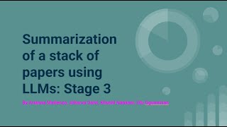
Demo
https://youtu.be/smVq01zN1ok

Slide 6
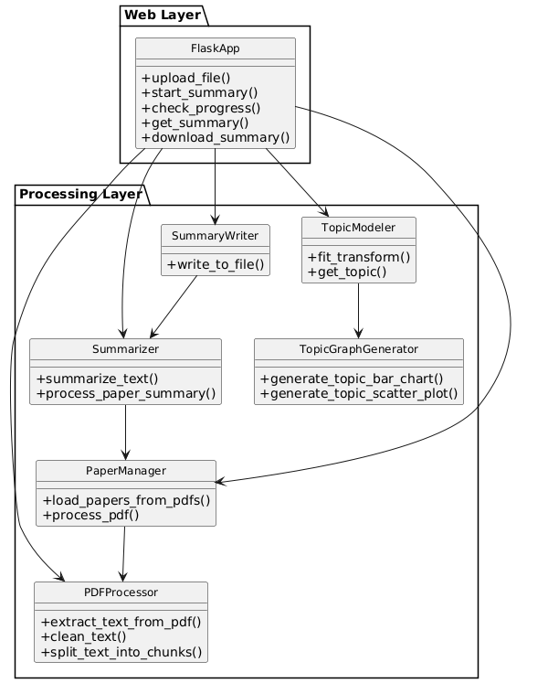
Class Diagram

Slide 7
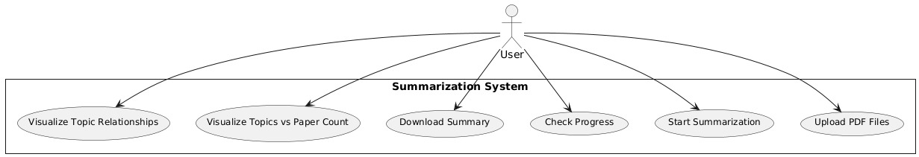
Use Case Diagram

Slide 8
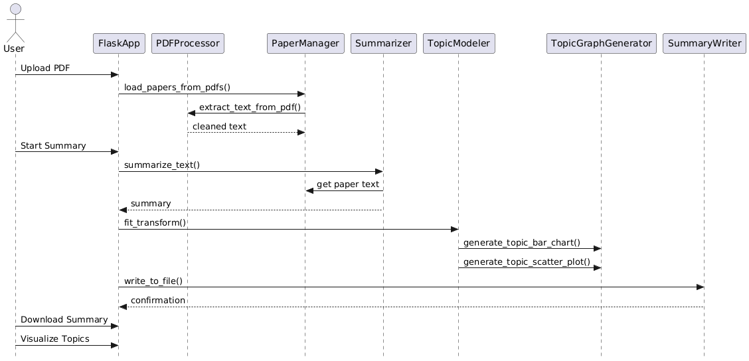
Sequence Diagram

Slide 9
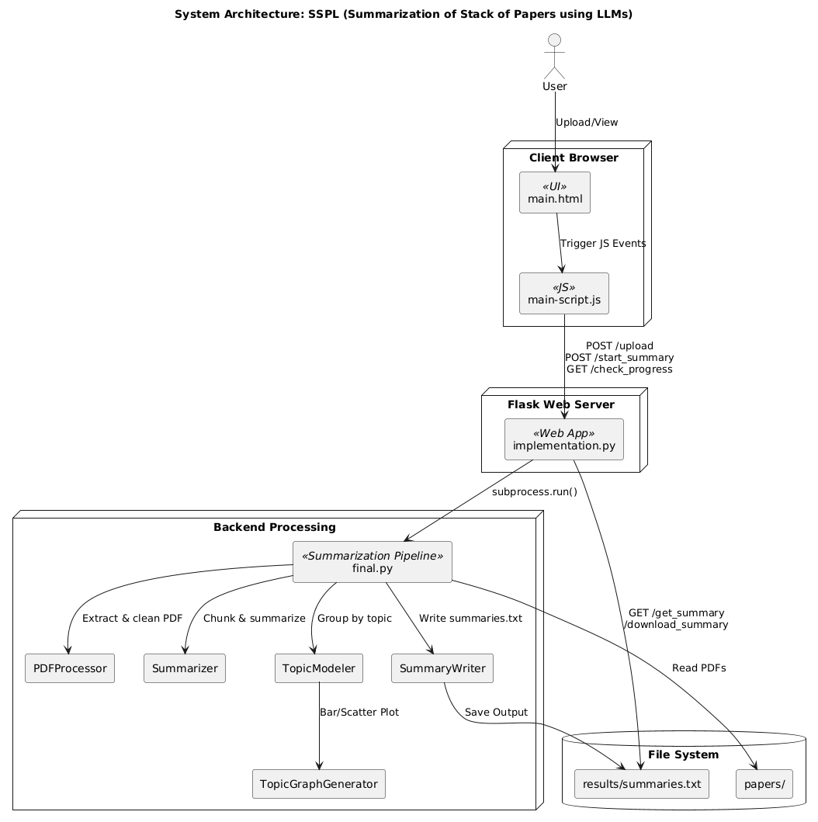
System Architecture

Slide 10
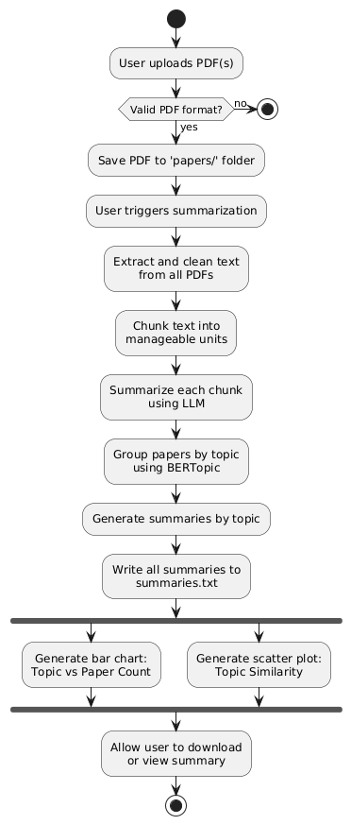
Flowchart

Slide 11
Local and Global Impacts
The local and global impacts of our project on individuals, organizations, and society are to meet the needs for efficient and effective ways to handle the vast amounts of academic literature produced every year.
Impact on Individuals:
Time Efficiency: Students and researchers can use this system to effectively summarize and save hours on reading materials. It will allow them to instead focus more on analysis, hypothesis generation, and advancing their own research.
Accessibility for Non-Experts: The system can make complex academic literature more accessible to individuals without deep domain specific knowledge.

Slide 12
Local and Global Impacts
Impact on Organizations:
Enhanced Research Productivity: Academic institutions, research organizations, and companies can improve their research productivity. Researchers can process large volumes of papers more quickly and identify valuable insights, helping organizations keep up with the rapid race of research development.
Increased Competitive Edge: For businesses, especially in fields like pharmaceuticals, tech, or engineering, the ability to efficiently process and synthesize research can give them a competitive edge. Staying ahead in research can lead to innovations that differentiate them in the market.

Slide 13
Local and Global Impacts
Impact on Society
Accelerated Innovation: By streamlining the literature review process, the project can speed up the discovery and application of new knowledge. This can drive advancements in critical areas such as medicine, climate change, engineering, and technology, benefiting society.
Improved Policy Making and Social Change: Governments and policymakers can use the system to synthesize research findings quickly and accurately, enabling them to make evidence-based decisions. This could be especially impactful in areas like healthcare policy, education reform, and environmental policy.

Slide 14


Slide 15


